Slide 1
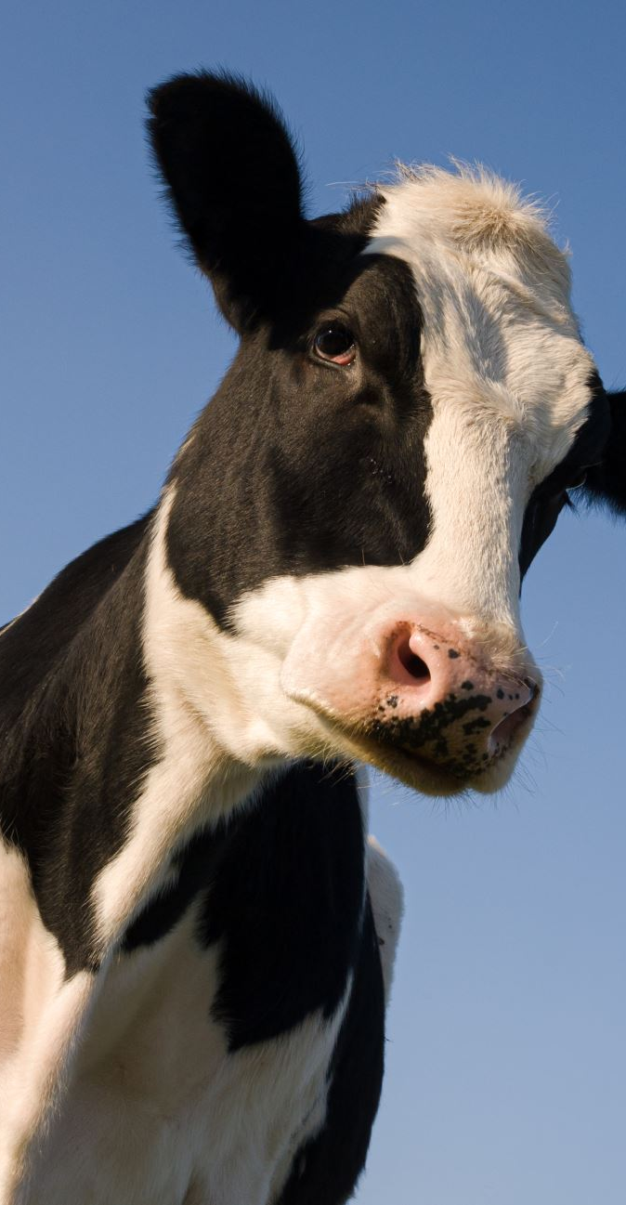
Predicting milk yield from cows using genetic markers
Capstone Project
Kay Anantanawat
11/05/2024

Slide 2
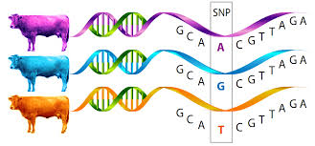
Background
DNA is the blueprint of every organism
SNPs = Single nucleotides polymorphisms
A change of one base in the DNA
Can affect the trait in the organisms even though it happens in the non-coding regions (junk DNAs).
Currently used by farmers to selectively breed the cow with the desire traits using linear regression.

Slide 3
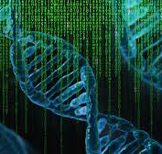
Current limitation
The amount of data is huge!
So much noise!
Other data are needed to narrow down a set of SNPs to work with.
Pedigree, the frequency of SNPs in the populations.
Not all SNPs are equal.
Strong effect – one or two SNPs
Moderate effect – small group of SNPs
Small effect – multiple groups of SNPS
Qualitative trait is complex

Slide 4
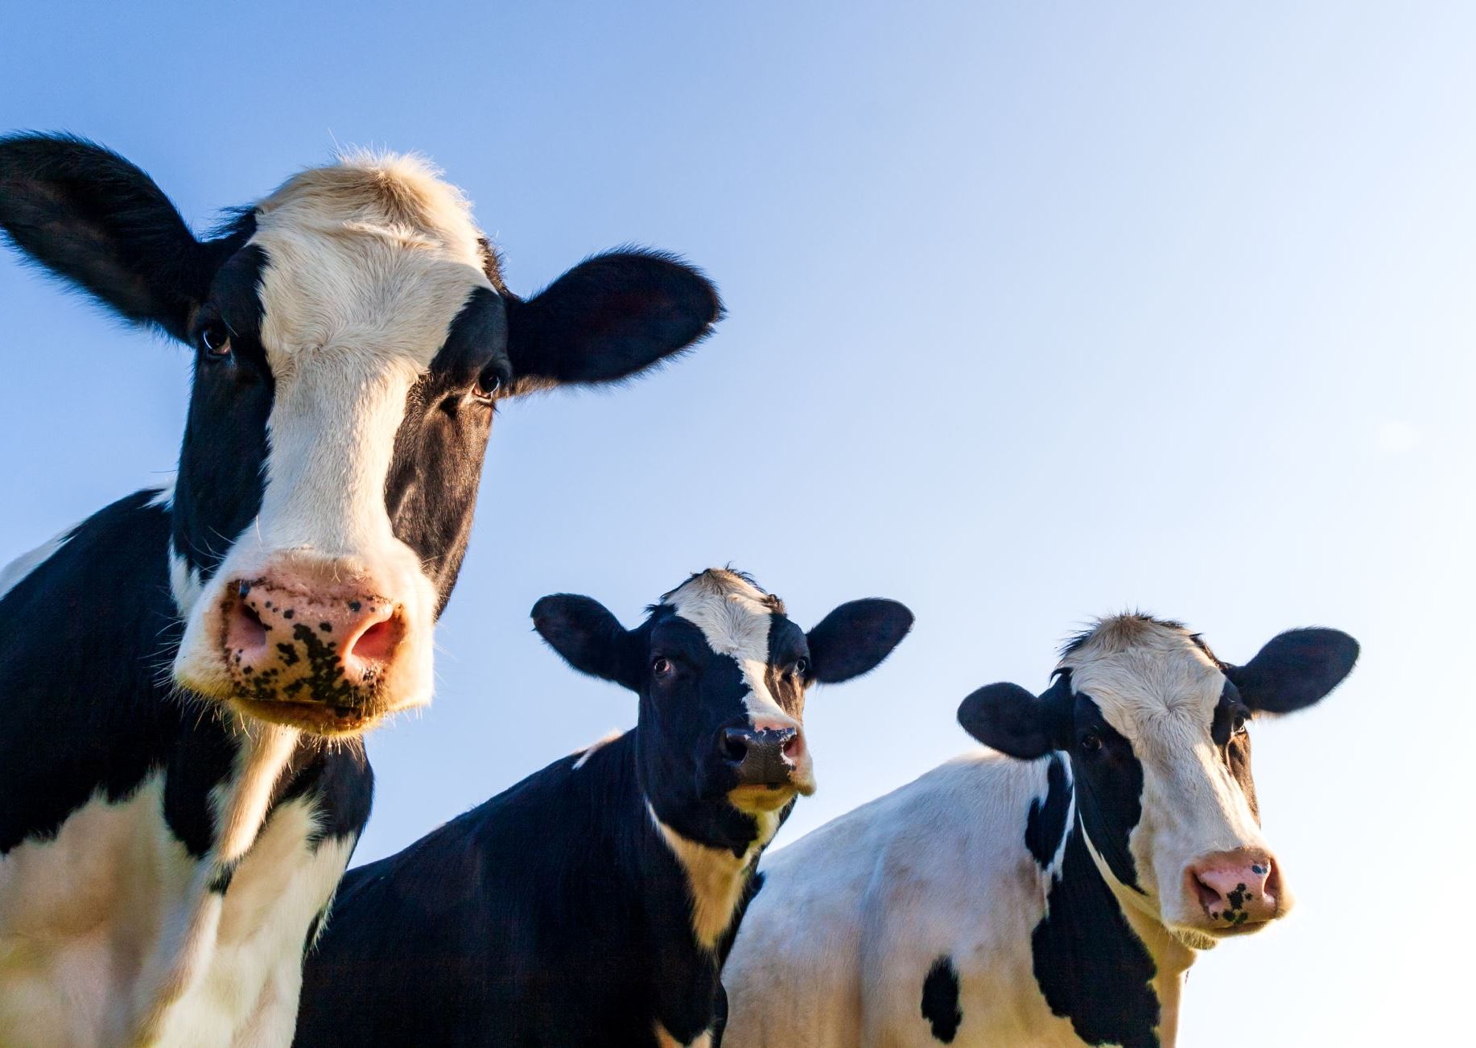
Business question
How to predict the milk production (milk yield) from the cow just by using SNPs data?

Slide 5
Data pipeline
Data cleaning
Exploratory data analysis
Model building
Remove SNPs with low diversity
Remove highly correlated SNPs
Check the distribution of the milk yield
Explore SNPs data
Split the data into test set, validation set and train set.
Build the model and adjust parameters

Slide 6
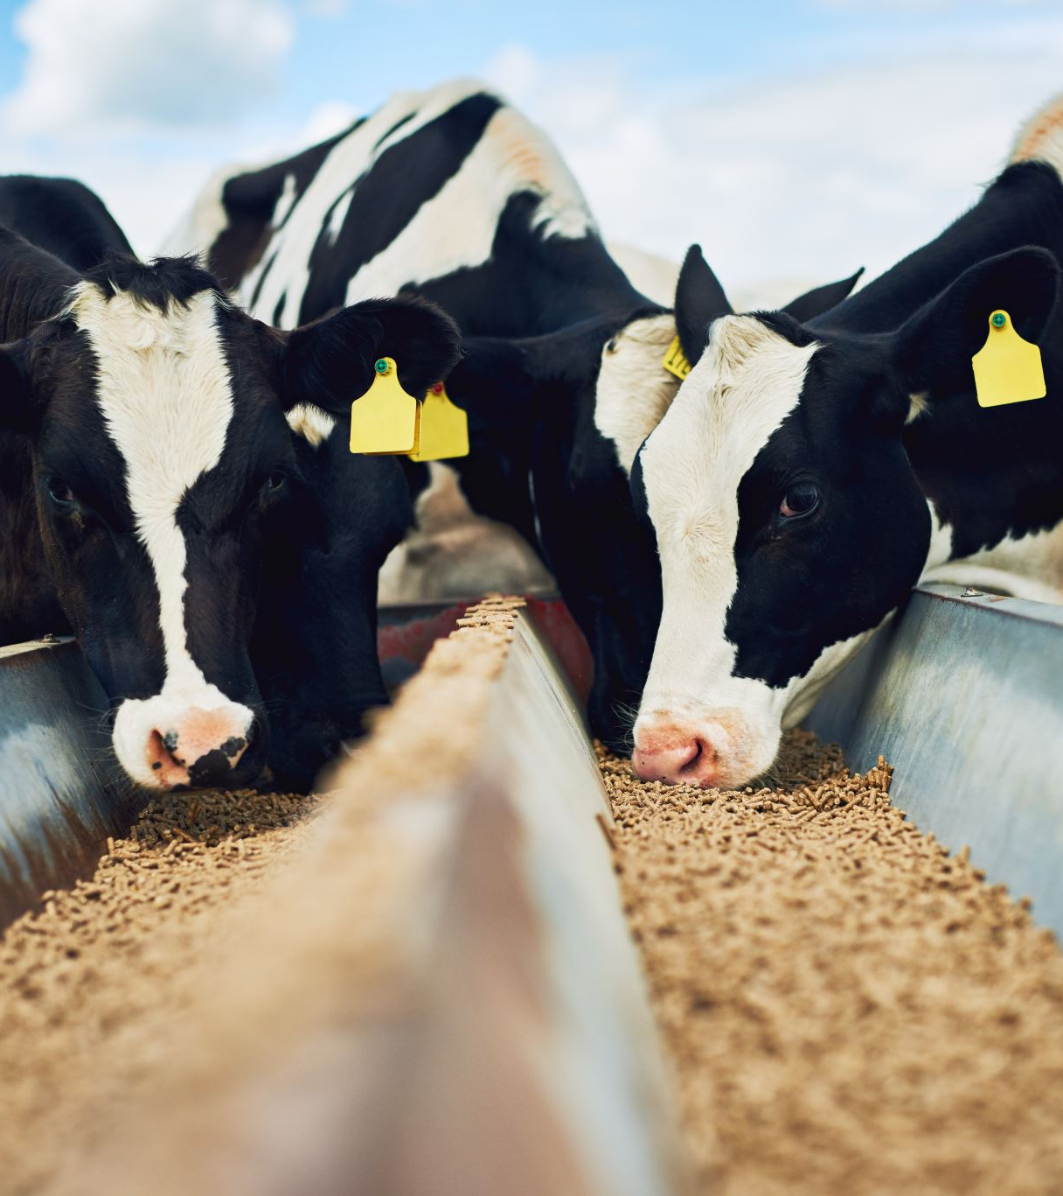
Data
The German Holstein Genomic Prediction Population
5024 bulls, provided by Vereinigte Informationssysteme Tierhaltung w.V.
42,551 SNPs
Focuses on 3 different traits:
milk fat percentage (FP)
milk yield (MY)
somatic cell score (SCS)

Slide 7
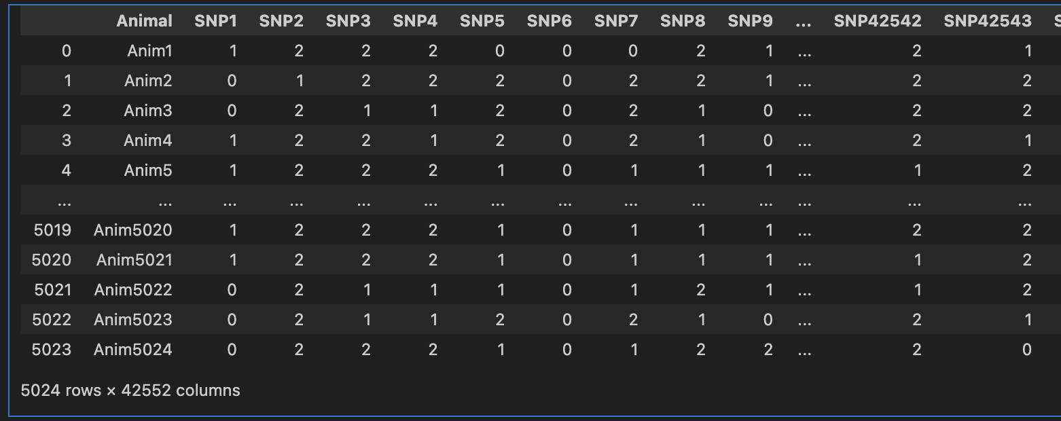
DATA
5,024 rows x 42552 features

Slide 8
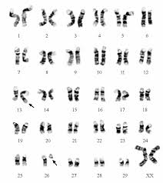
SNPs value – 0,1,2
A cow has 2 copies of genes.
The mutation is in comparison to the reference cow.
0 = No changes or mutations
1 = 1 copy contains a mutation
2 = 2 copies contain mutation

Slide 9
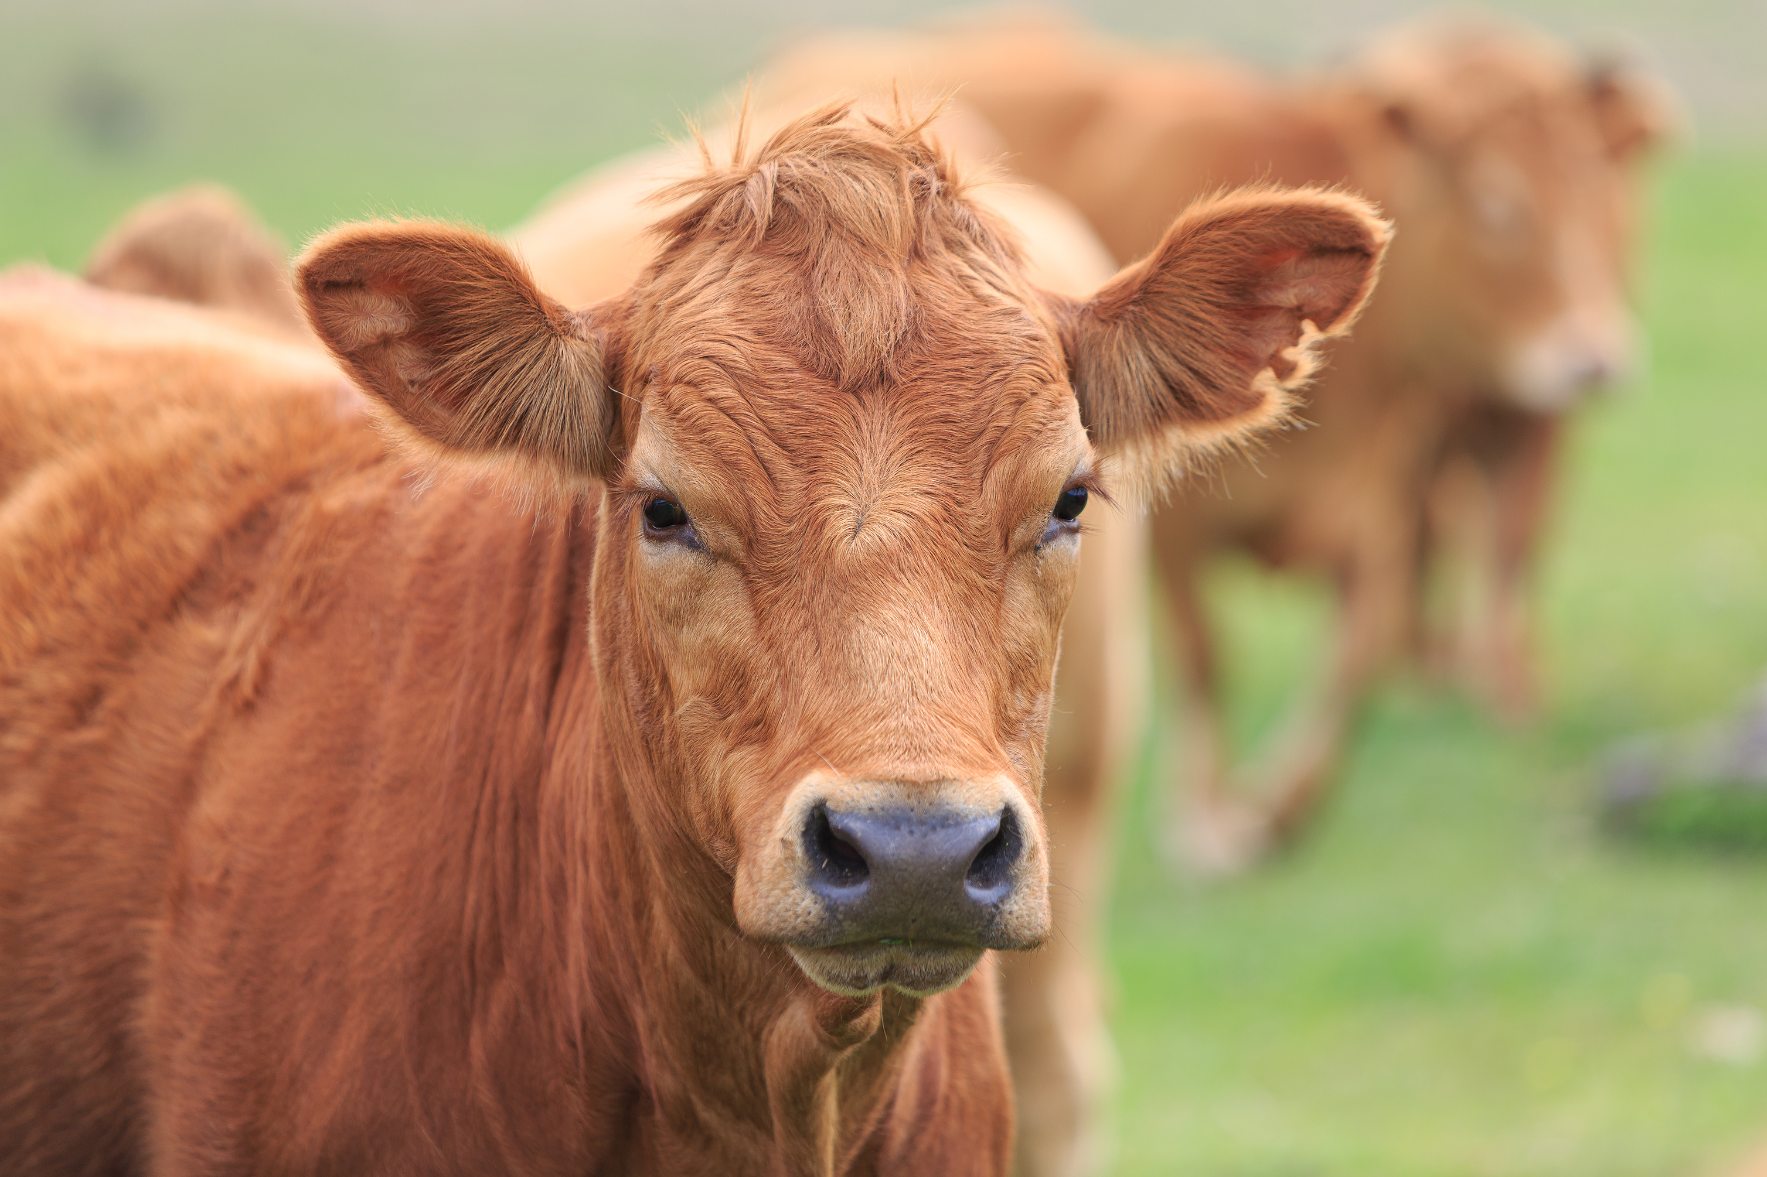
Estimated Breeding Value for Milk yield
Not preferable
reference cow
Preferable
- 3
0
+ 3

Slide 10
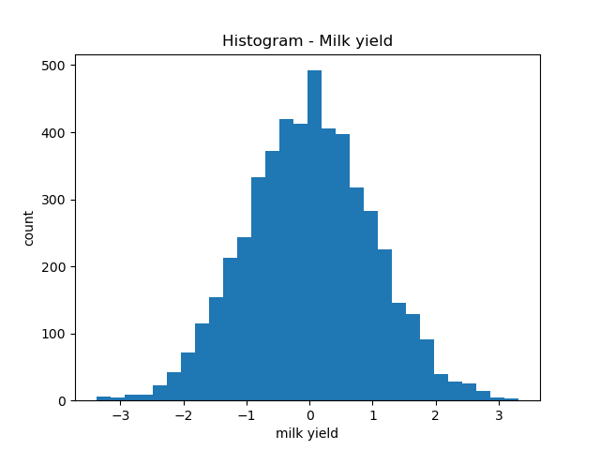
Milk yield

Slide 11
Filtering features
42,552 SNPs
Remove SNPs that are expressed in the same form in 80% of the bulls
34,792 SNPs
Remove SNPs that are dependent to each other using Chi-Square test and Crammer V.
4,157 SNPs

Slide 12
Model
80% of the data is used for training
4 different models:
Multi-layer perceptron (MLP)
Convolution neuron network
Convolution neuron network with L1 regularization
Convolution neuron network with L1 and L2 regularization

Slide 13
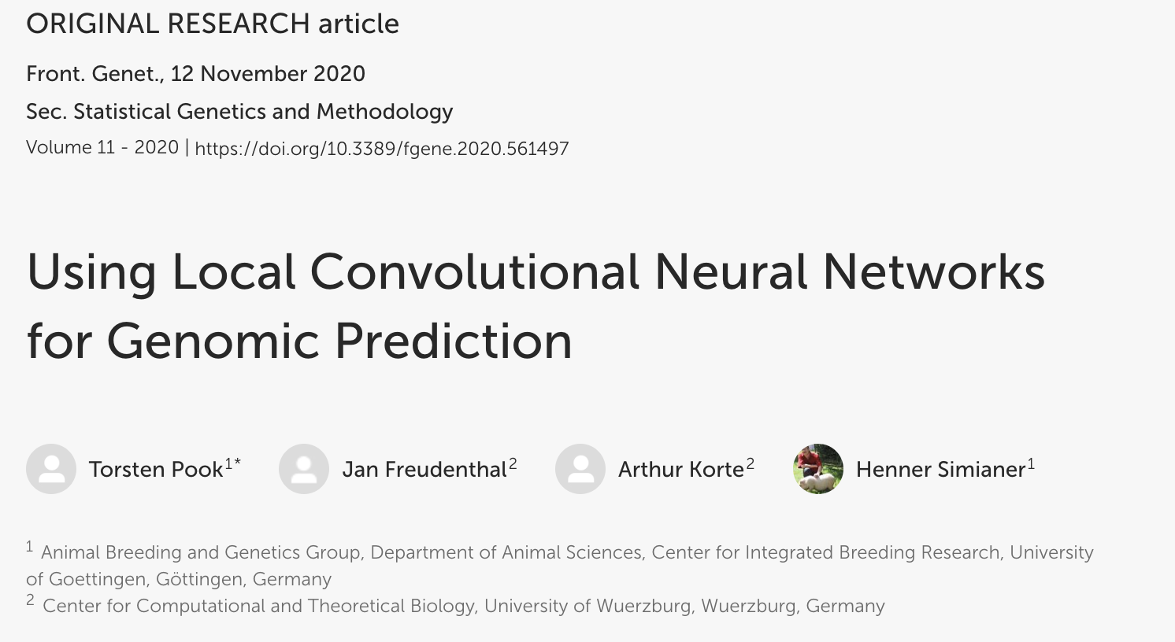

Slide 14
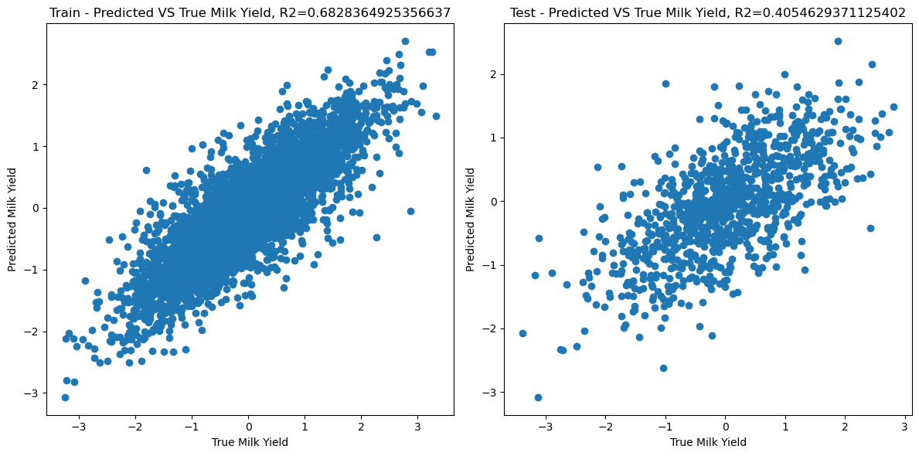
Model 1: MLP

Slide 15
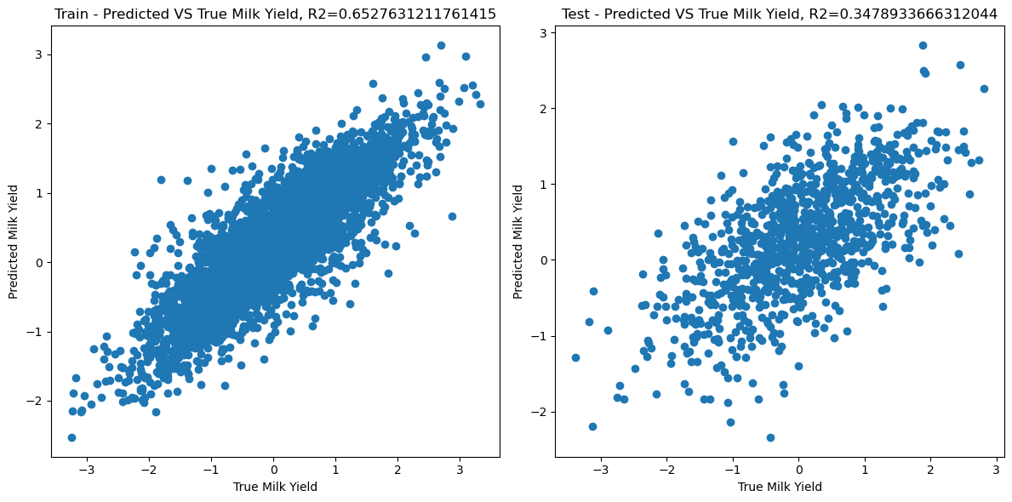
Model 2: CNN

Slide 16
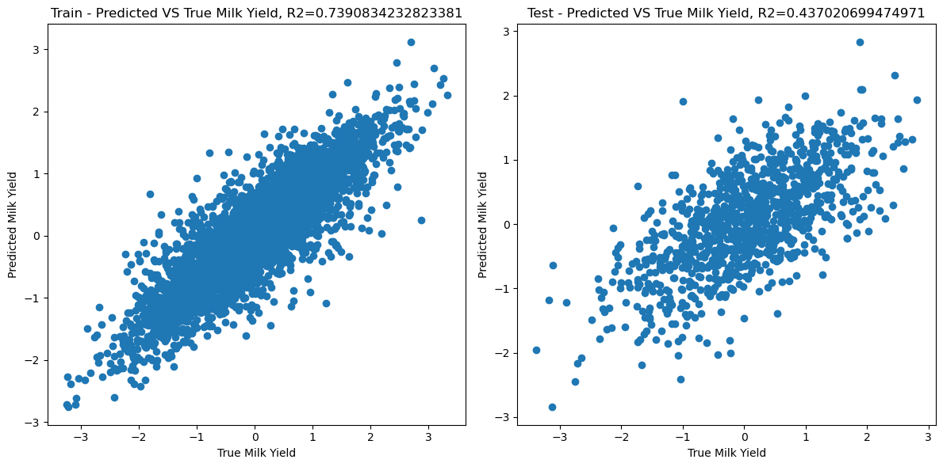
Model 3: CNN + L1

Slide 17
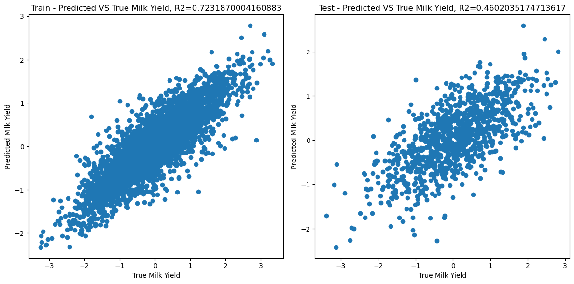
Model 4: CNN + L1 + L2

Slide 18
CNN with L1 and L2 regularization performs better in terms predicting the testing set.

Slide 19
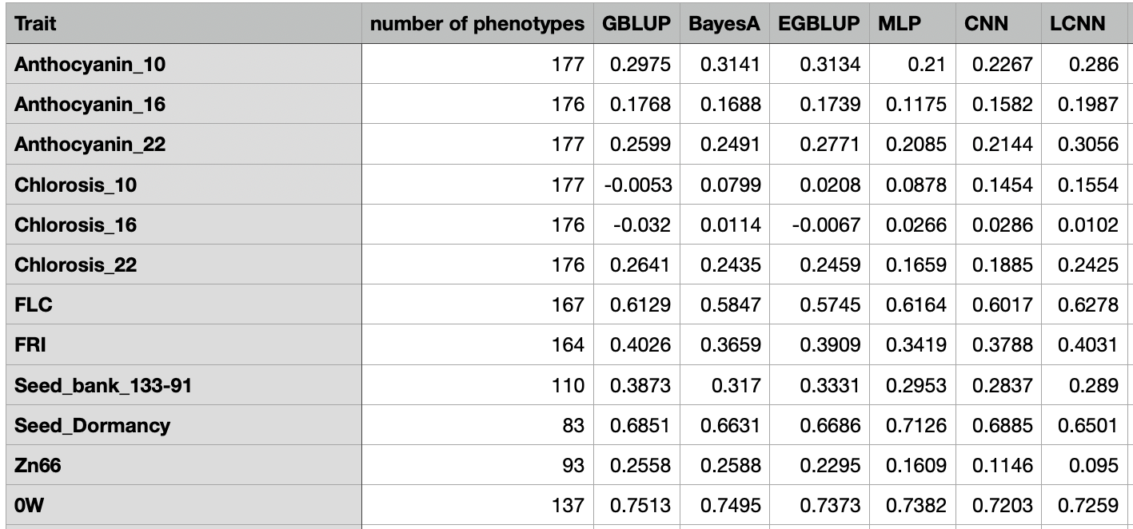
Models perform differently for different traits. Data from Pook et al., 2020

Slide 20
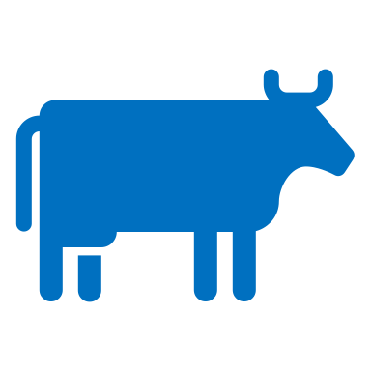
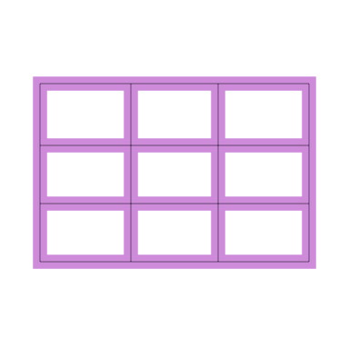
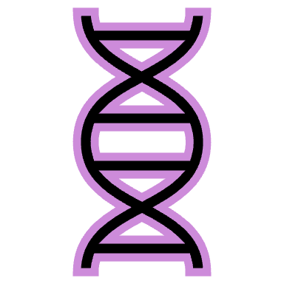
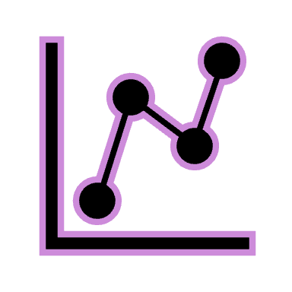
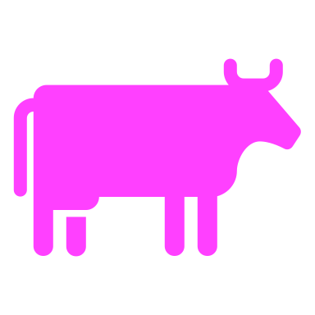
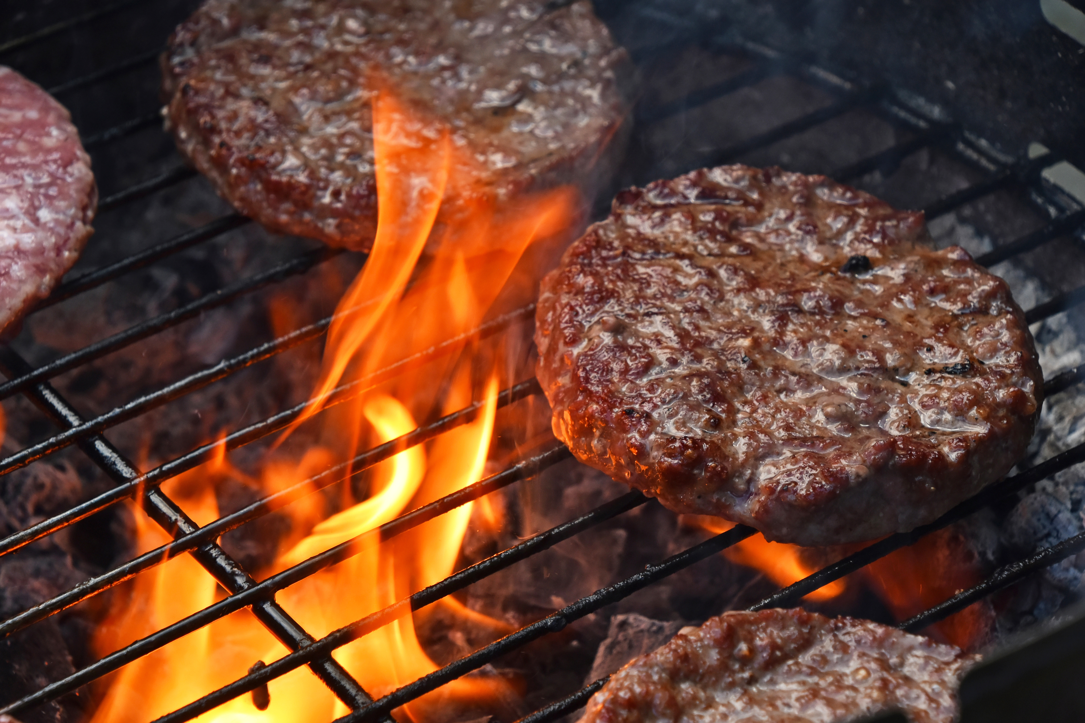
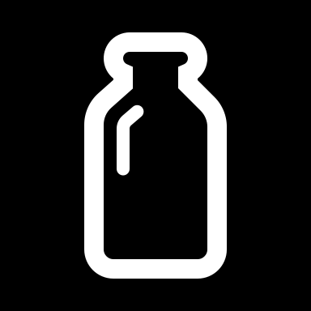
Model Implementation
X

Slide 21
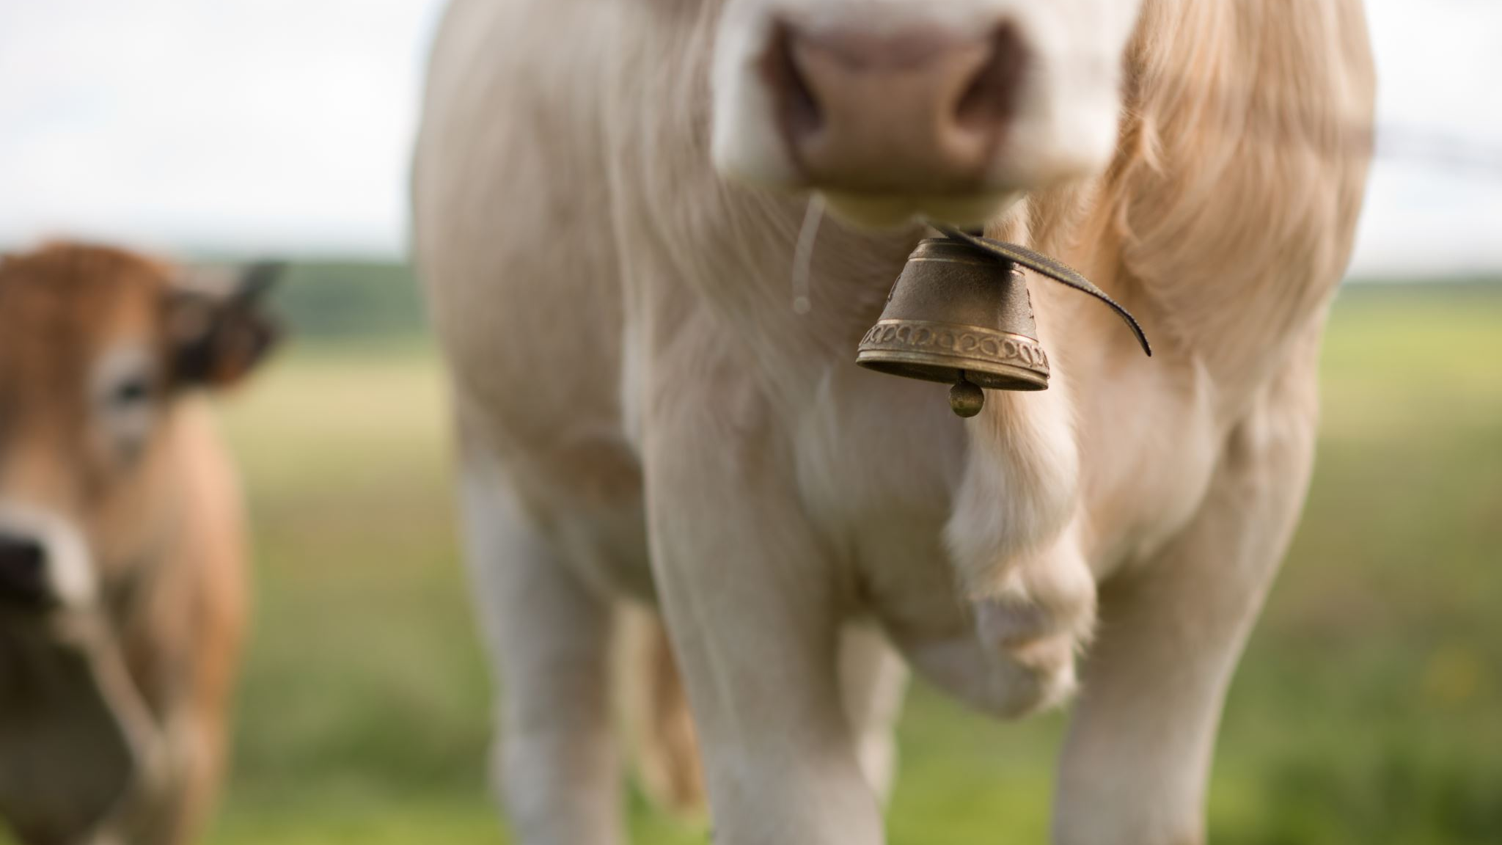
NEXt
More research into the nature of the data
Refine the model to solve overfitting.

Slide 22
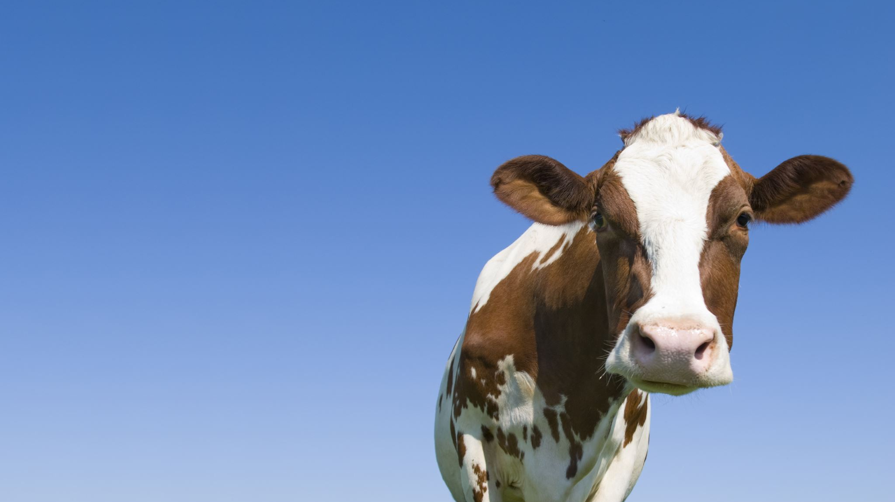
Thanks! Q&A

